Slide 1
Development of a Microvibration and Torque Measurement Device for Reaction Wheel Assemblies
Presenters: Brodie Cruse & Matthew McGill
Supervisor: Dr Guglielmo Aglietti
Notes:
Introduction

Slide 2
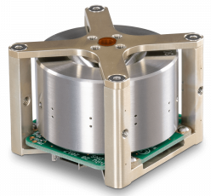
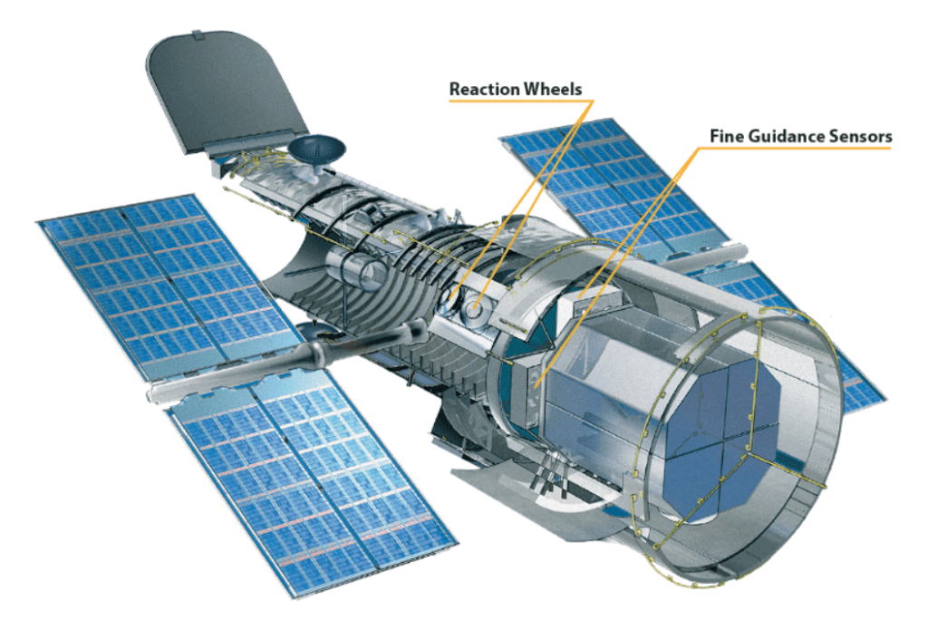
Problem Statement
Reaction Wheel Assemblies (RWAs) are the primary attitude control actuator on satellites
During operation they generate microvibrations that degrade payload performance
Accurate characterisation of forces, torque, and imbalance is critical for mission success

Slide 3
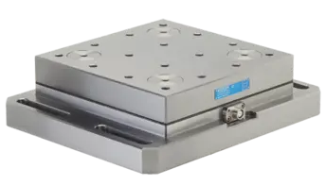
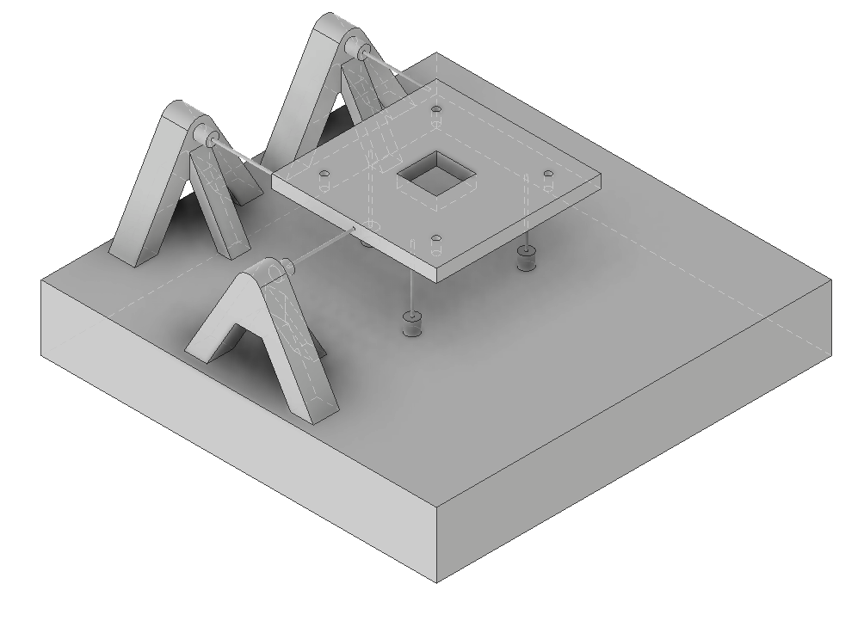
Objective & Industry Solutions
Objective: Build a unified device to measure RWA microvibration, imbalance, and torque
Industry standard: Kistler dynamometers – cost upwards of $100,000
Our goal: Replicate the function at a fraction of the cost.
Expensive → Cheap(er) equivalent

Slide 4

Microvibration Measurement
Microvibrations: Tiny oscillating forces caused by imperfections in the RWA during spin
Measurement | Method | Sensor(s) | Realistic Target
Microvibration | FFT of all six force and moment components F_{x}, F_{y}, F_{z}, M_{x}, M_{y}, M_{z} | 6 Force sensors | Resolution of 10 to 50 mN (millinewtons)

Slide 5
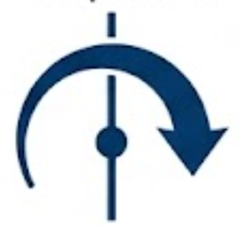
Torque Measurement
Torque: The reaction torque delivered about the wheel's spin axis
Measurement | Method | Sensor(s) | Realistic Target
Torque | Differential F_{x} reading | Two x-axis force Sensors | Moment increments of 1 to 5 mN∙m

Slide 6
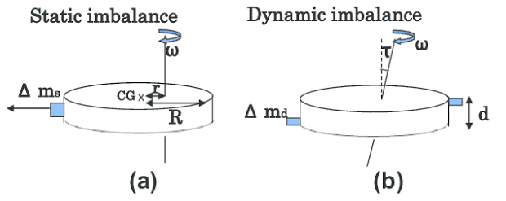
Imbalance Measurement
Static Imbalance:
mass offset from the centre of rotation
Dynamic Imbalance: axis of rotation misaligned from the principal axis of inertia
Measurement | Method | Sensor(s) | Realistic Target
Static imbalance | Centrifugal force at spin frequency ω | Force Sensors + Tachometer | Resolution of 20 to 50 g∙mm
Dynamic imbalance | Requires two measurement planes – future work | — | Resolution of 100 to 250 g·mm²

Slide 7
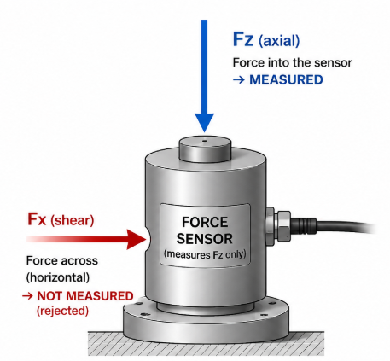
Decoupling Problem
Constraint: Each sensor can only respond to forces along its own axis
The issue: Off-axis force escapes through the rigid structure instead of reaching its sensor, causing under-reporting
The solution: A load path that decouples each axis from the others
Notes:
Explain physically why cross-talk matters: if radial load bleeds into the axial channel, imbalance measurements get corrupted.
State the stinger principle in plain language - stiff in the direction you're measuring, floppy in the others.
Keep it brief, this is context for the concept comparison slide next.

Slide 8
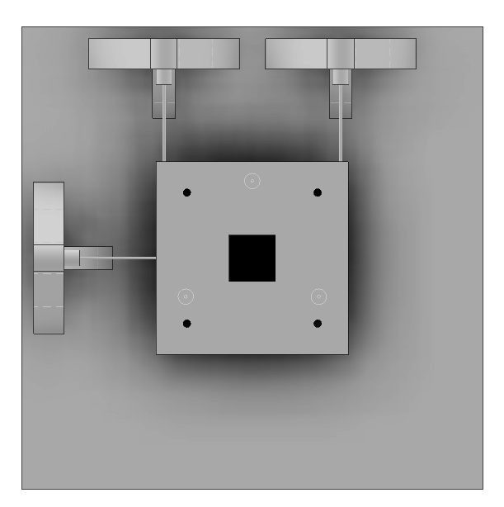
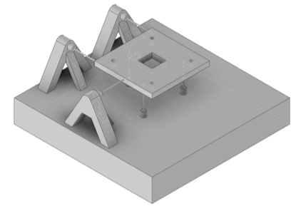
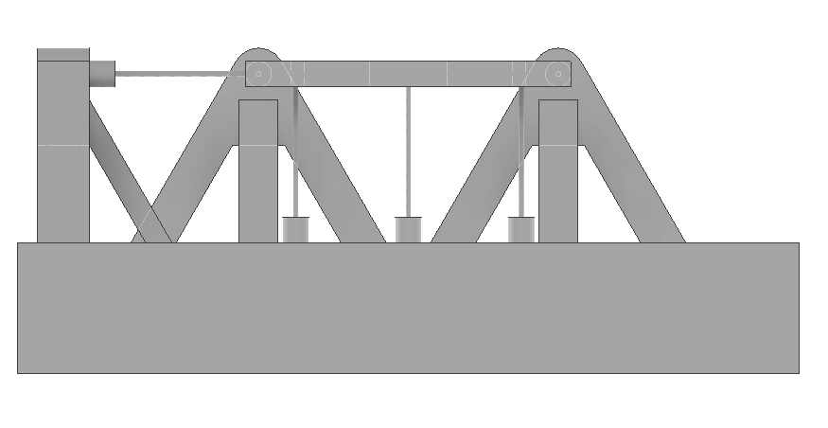
Proposed Stinger Decoupling System
6 stingers + 6 force transducers
Mounting plate for RWA
Heavy base to reduce background noise
Support brackets for radial sensors
Clean single load path for each force
Resonant frequency considerations
Notes:
Ball bearing plate needed preload to stay seated - an extra failure mode and extra complexity.
Stinger needs no pretensioning, gives a clean single load path, and only six components to manufacture and align.
Let the CAD image do the work - don't over-narrate the sketch.

Slide 9
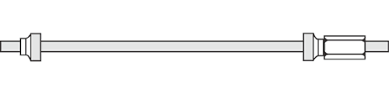
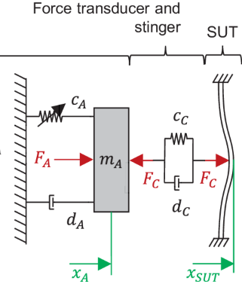
Stinger Design Analysis
D
L
Example analysis: D = 2mm, L = 50mm
Check | Target | Axial | Radial
f_{n} [Hz] | > 500 | 892.1 ✓ | 515.0 ✓
k_{ax}/k_{lat} | > 3000 | 3333 ✓ | 3333 ✓
SF_{buckle} | > 5 | 100.9 ✓ | 241.7 ✓
SF_{yield} | > 3 | 6.4 ✓ | 4671.6 ✓
Notes:
Say plainly: four checks per stinger, all four passed for the selected geometry (d = 2 mm, L = 50 mm, steel).
Natural frequency > 500 Hz keeps the stinger's own resonance out of the measurement band (one-third rule: fn > 3x max measurement frequency).
Stiffness ratio > 3000 keeps axial and radial channels decoupled - cross-axis error under 0.03%.
Buckling and yield margins are comfortable at this diameter - steel is well within capability.
Don't derive the equations live - just say "we check four things to make sure the stingers work" and walk through the results table.

Slide 10
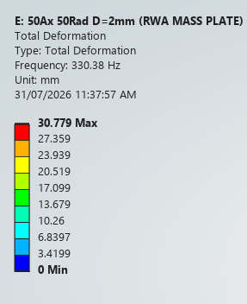
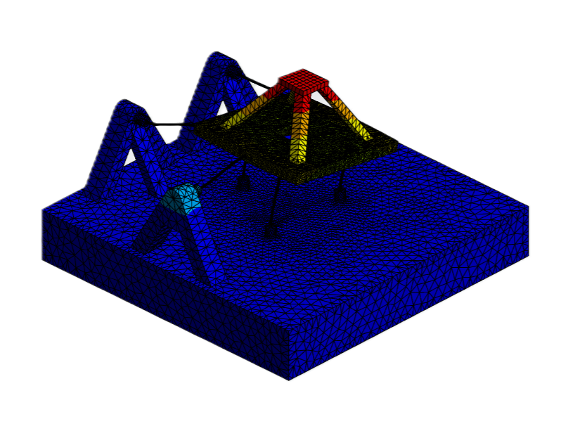
FEA Modal Analysis
Mode | Description | Freq [Hz]
1 | Lateral translation – X | 334.5
2 | Lateral translation – Y | 396.8
3 | Torsion about Z | 696.4
4 | Axial bounce – Z | 892.7
5 | Rocking about X | 965.7
6 | Rocking about Y | 998.8
FEA Modal Analysis – mode 1 deformation D = 2mm L = 50mm
Notes:
Full body assembly modal analysis in ANSYS - RWA represented as a 1.0 kg point mass at the rotor centre-of-mass height.
First six modes: two lateral translation (334 Hz, 397 Hz), torsion (696 Hz), axial bounce (893 Hz), two rocking modes (966 Hz, 999 Hz).
Be upfront: Modes 1 and 2 sit below the 500 Hz target - that's support compliance in the radial stingers, not a fundamental flaw.
Fix already identified: stiffen the radial stinger supports (increased wall thickness), planned as the first Semester 2 design iteration.
"Mode 1 is below target due to support compliance - we've identified the fix for Semester 2".

Slide 11
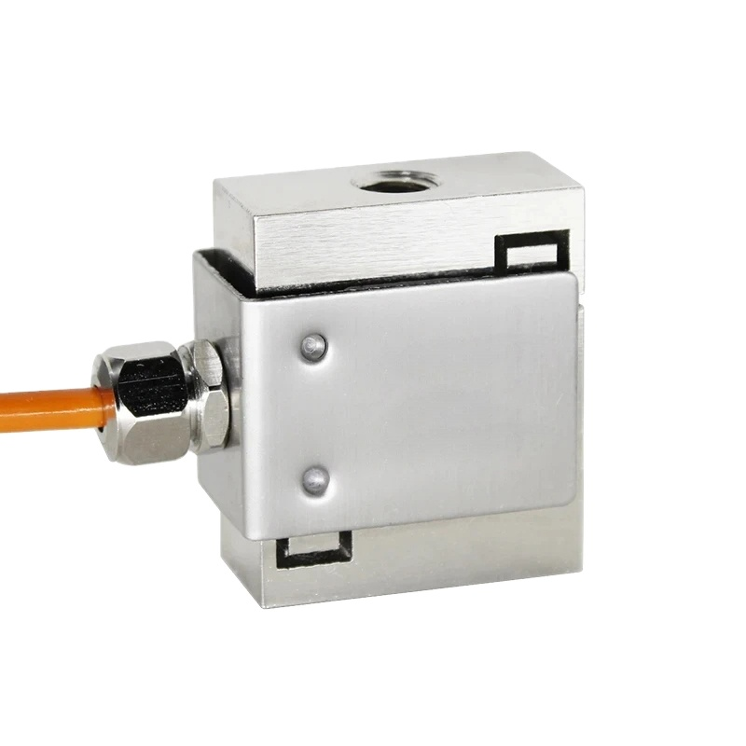
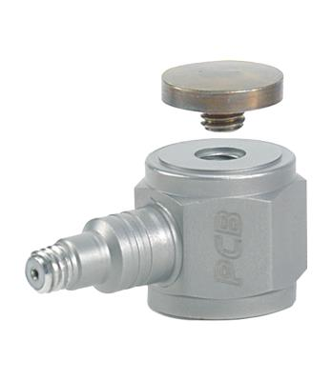
Sensors
Sensor | Role
S-beam strain gauge | High-precision static/low-frequency load
PCB 208C01 | High-frequency microvibration bandwidth
Notes:
Axial channel needs high-precision static/low-frequency load measurement - S-beam strain gauges suit that role.
Radial channel carries the higher-frequency microvibration content - ICP piezoelectric (PCB 208C01) is built for that bandwidth.
One line: each sensor type is matched to the physics of what it measures, not a single one-size-fits-all sensor.

Slide 12
Next Steps
1
2
3
4
Detailed
design
DAQ System
Fabrication
Experimental
validation
Target: working proof of concept by late September
Notes:
Walk through the five-step path: sensor procurement -> static FEA -> detailed design -> fabrication -> validation.
Say the key dates out loud briefly - don't just point at the Gantt and move on.
End confidently: "by October we will have a working proof of concept".

Slide 13
THANKS FOR LISTENING

